Slide 1
DCAITI-Project: rear-view mirror for cyclist on Smartphones
Oday Kabha oday.kabha@ipk.fraunhofer.de
name @campus.tu-berlin.de
name @mailbox.tu-berlin.de
Supervisor: Marcus Witzke

Slide 2
Overview
Idea
Develop Framework
System Architecture
Solution Approaches (CANBERK)
Milestone
18.11.2020
DCAITI -Projekt

Slide 3
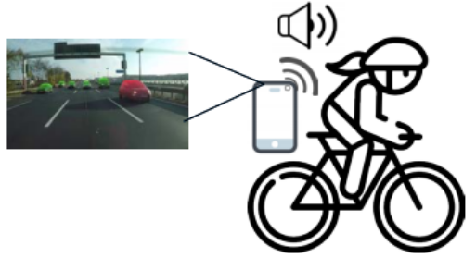
1. Idea
Object Detection & Tracking:
Smartphone cam
Additional cam
Image processing Algorithms
Measurement of Distance & Speed:
Simple smartphone cam using image processing algorithms
LiDAR
Notifications & Warnings
When objects too close or too fast
Android Notification Reciever
18.11.2020
DCAITI -Projekt

Slide 4
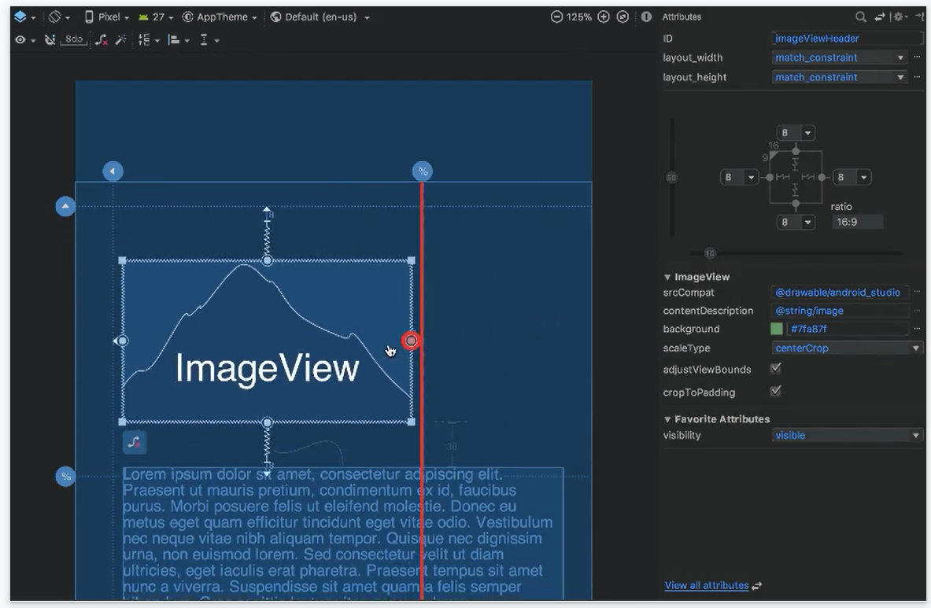
2. Develop Framework
Android Studio
1. Visual layout editor
build layouts by dragging UI elements instead of writing layout XML by hand
18.11.2020
Source: https://developer.android.com/studio
DCAITI -Projekt

Slide 5
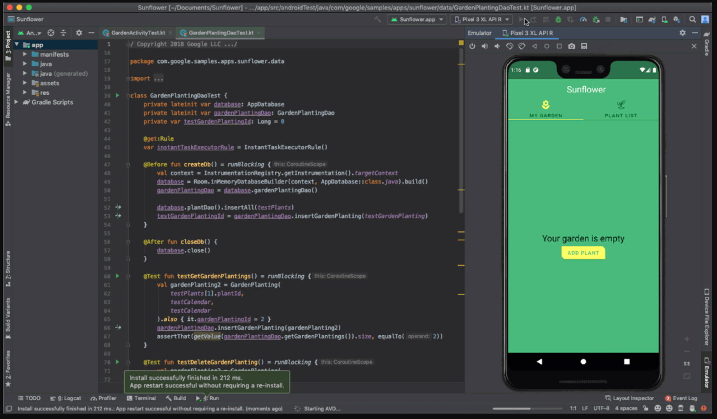
2. Develop Framework
Android Studio
2. Fast emulator
run apps on the Android Emulator
18.11.2020
Source: https://developer.android.com/studio
DCAITI -Projekt

Slide 6
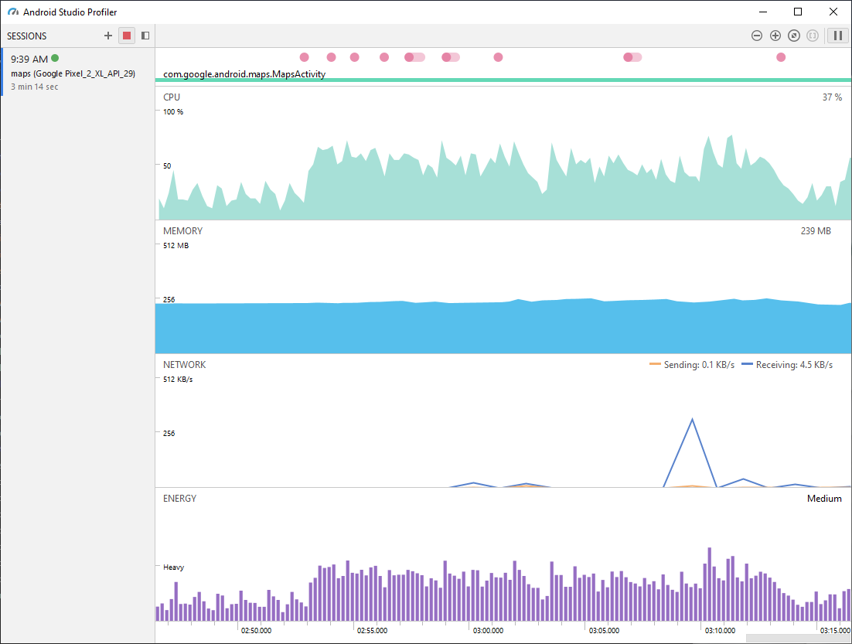
2. Develop Framework
Android Studio
3. Intelligent code editor
based on IntelliJ IDEA
4. Realtime profilers
measure app performance
18.11.2020
Source: https://developer.android.com/studio
DCAITI -Projekt

Slide 7
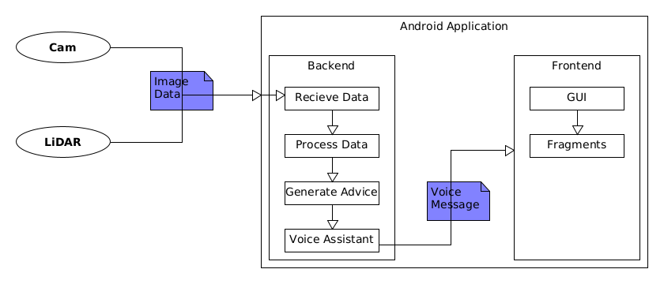
3. System Architecture

Slide 8
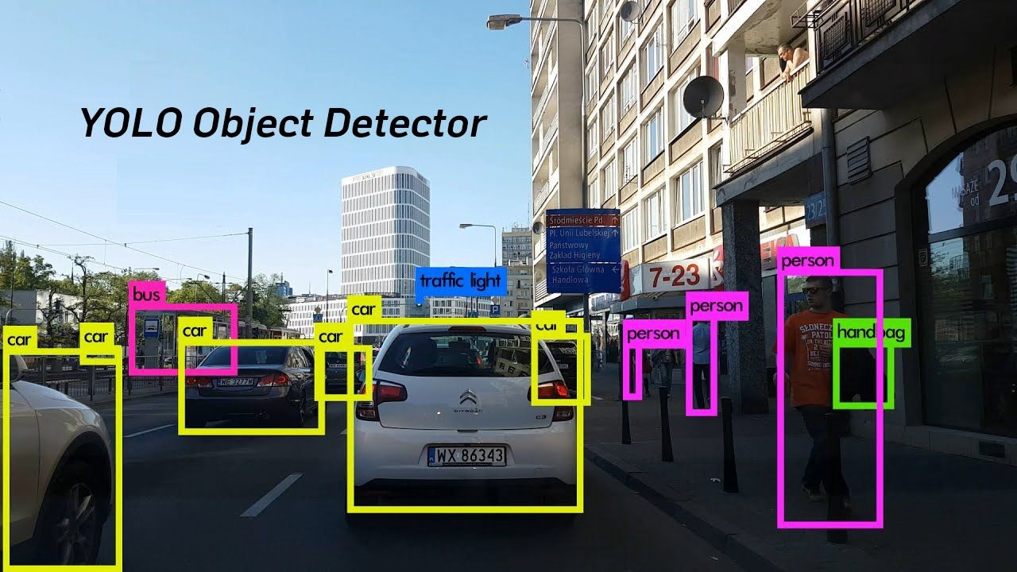
4. Solution Approaches
Vehicle Detection
YOLO (You only look once)
MaskRCNNs
Detectron2

Slide 9
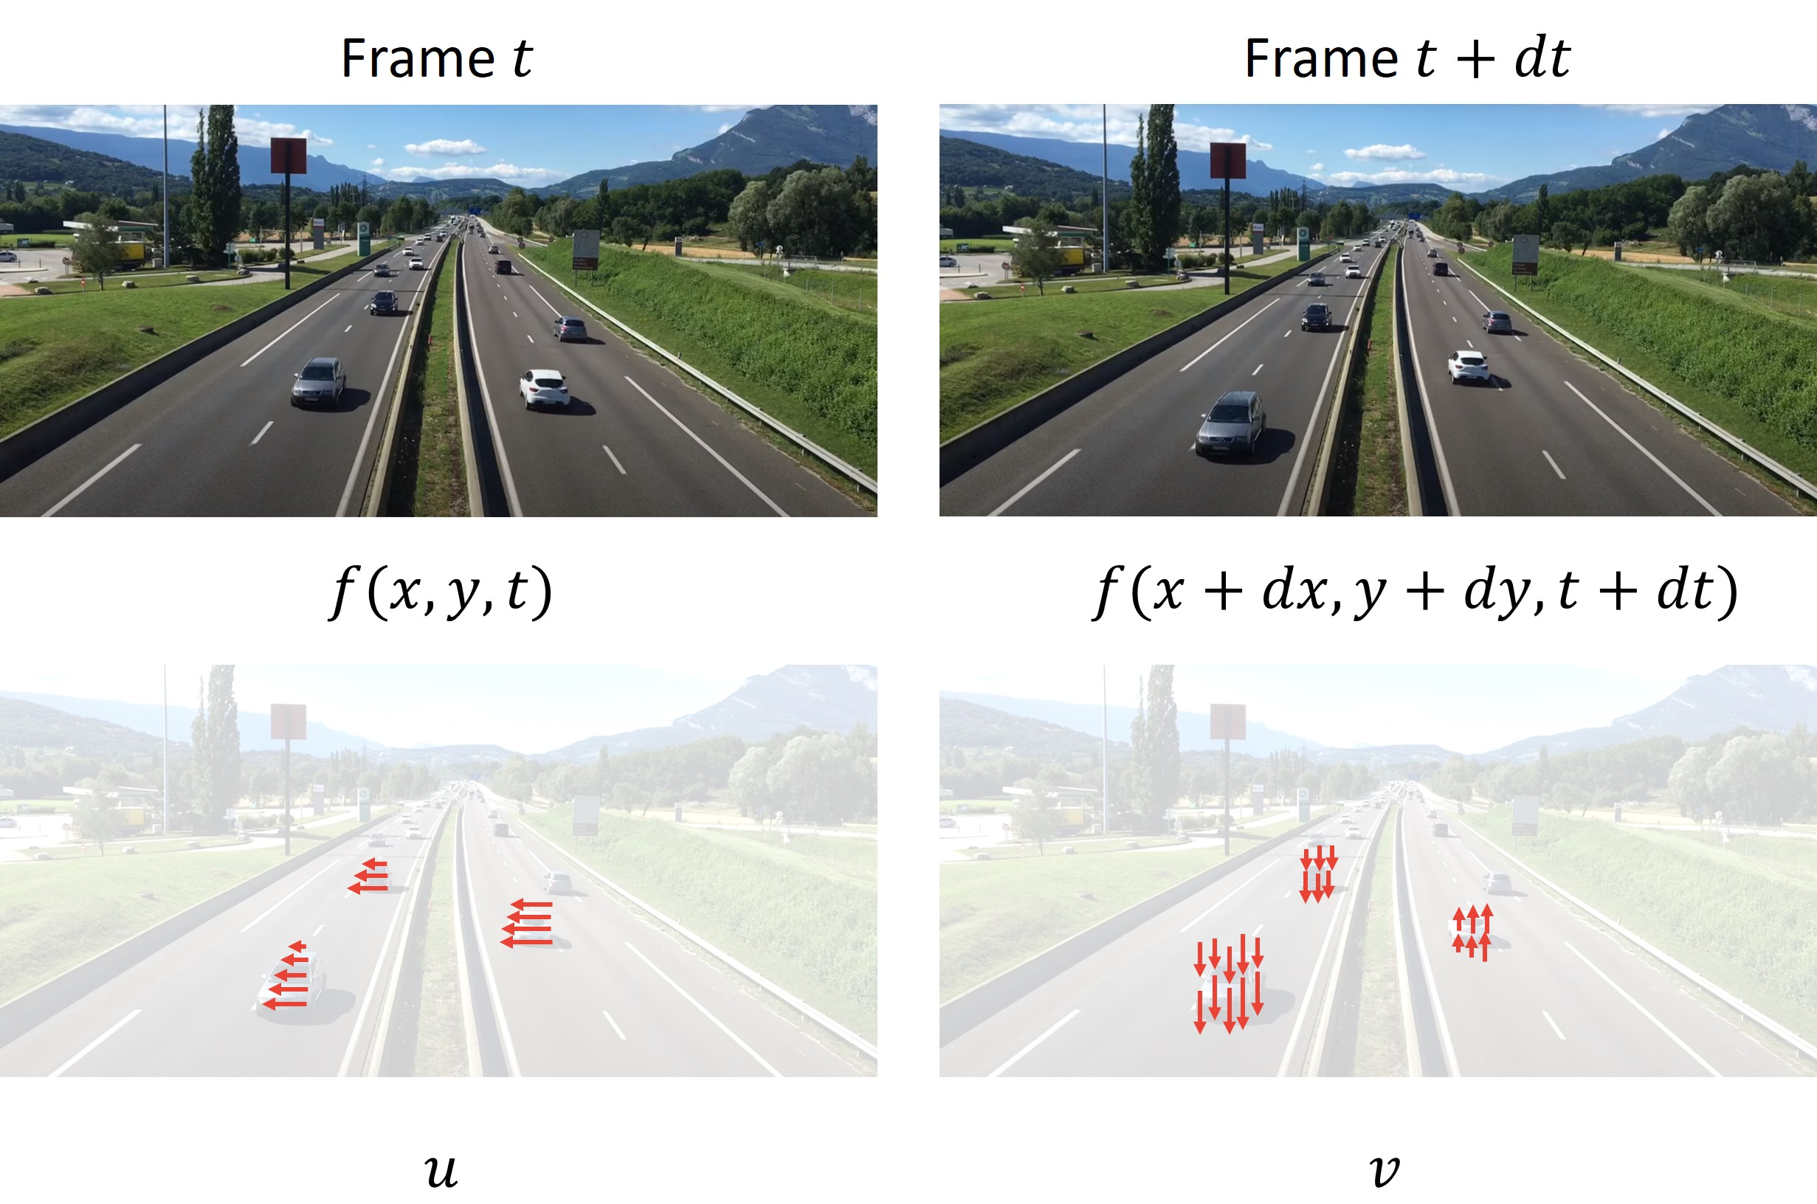
4. Solution Approaches
Tracking
Sparse Optical Flow
Lucas-Kanade-Methode
Elementary Motion Detector

Slide 10
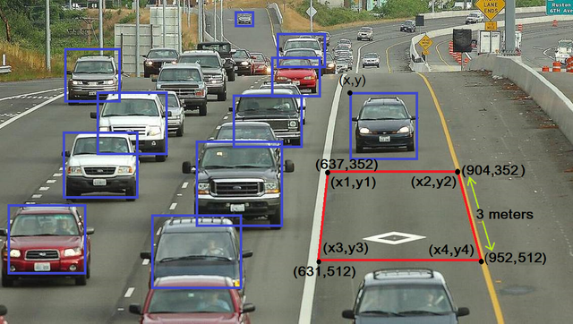
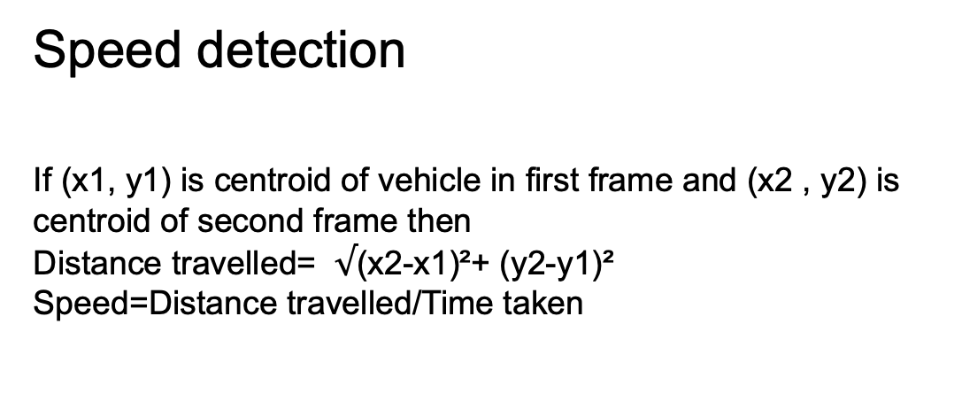
4. Solution Approaches
Speed detection
If (x1, y1) is centroid of vehicle in first frame and (x2 , y2) is
centroid of second frame then
Distance travelled= $√$(x2-x1)²+ (y2-y1)²
Speed=Distance travelled/Time taken
Notes:
Distance is calculated using the centroids of previous and next
frames. For distance calculation, Euclidean distance is used.
Time is calculated as vehicle enters the ROI. Initially the
speed is calculated using the formula

Slide 11
5. Milestone
05
06
07
08
Set Up
Phase I
Phase II
Phase III
Fine Tuning
Documentation

Slide 12
5.Milestone
13.05
31.05.
17.06.
01.07.
15.07.
Set Up
Phase I
Phase II
Phase III
Fine Tuning
Set Up
Projects
Admins
Projektplanung
Mockups
User Stories
Einarbeitung Android
Timeline Komponente
Tasks in Timeline Tasks
Projekte
Tasks zu Personen zuweisen
Abhängigkeiten zwischen Tasks ermöglichen
Funktionalität gewährleisten
Feinschliff

Slide 13




Interne Organisation
Kommunikation über Slack/WhatsApp
Wöchentliche Zoom-Meetings
Statusbericht
Absprache der nächsten Schritte
Verteilung der Aufgaben
Trello zur Organisation
Github

Slide 15
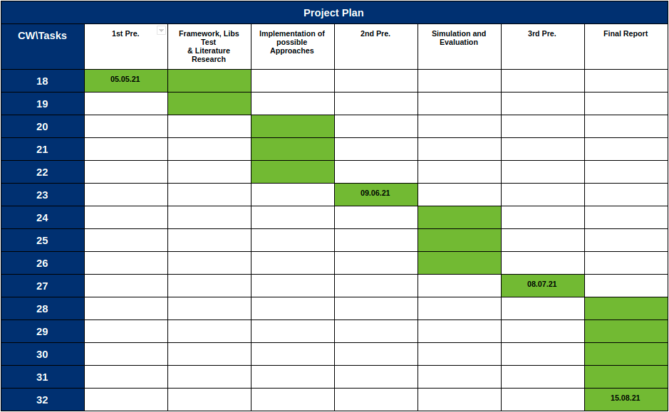
5. Milestone
18.11.2020
DCAITI -Projekt

Slide 16
Thanks for your attention!
Oday Kabha oday.kabha@ipk.fraunhofer.de
name name@campus.tu-berlin.de
name name@mailbox.tu-berlin.de

